Slide 1
Fort George River Issues & Options for Discussion Presented to the Jacksonville Waterways Commission December 11, 2019

Slide 2
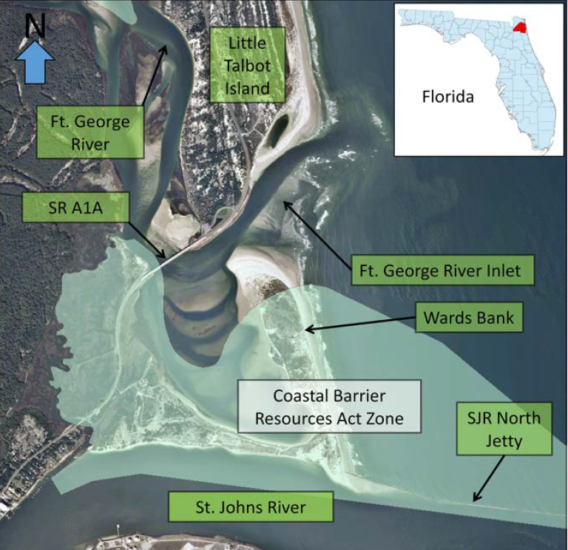
Ft. George Inlet & River
USACE - 2015

Slide 3
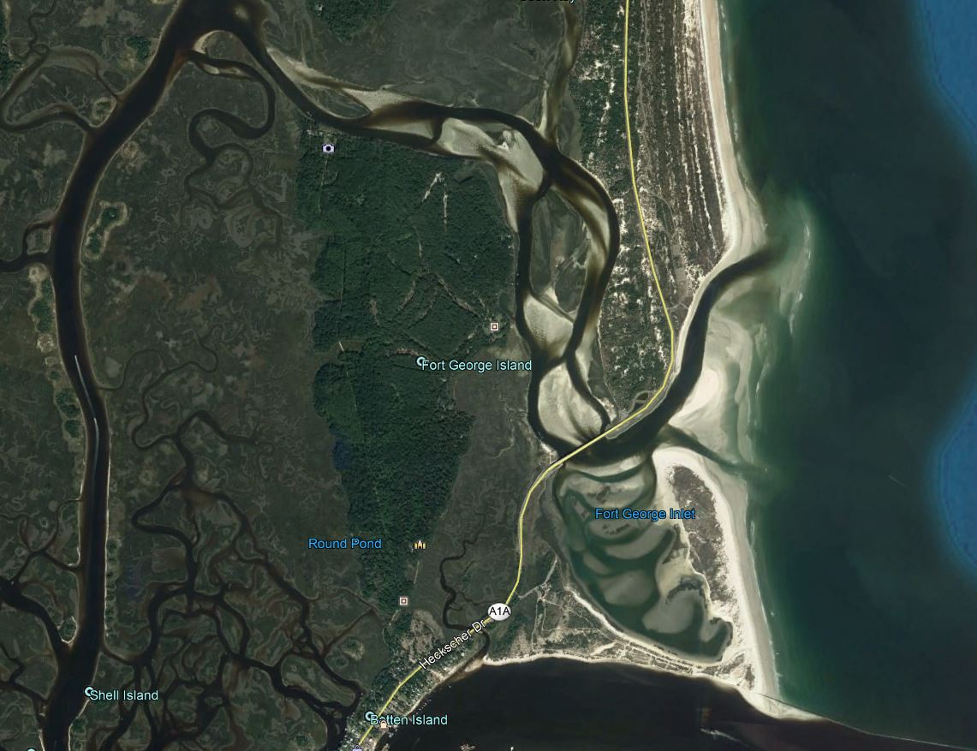
Ft. George River – 2018
Google Earth

Slide 4
Ft. George River – Adjacent Property Owners
STATE OF
FLORIDA
USA
STATE OF
FLORIDA
USA
COJ
NATURE CONSERVANCY
STATE OF
FLORIDA
STATE OF
FLORIDA
COJ
NATURE CONSERVANCY
STATE OF
FLORIDA
COJ
USA
USA
Google Earth

Slide 5
Ft. George River – Land Managers
FPS
FIND
NPS
FPS
COJ
NPS
FPS
FDEP - Nassau River-St. Johns
River Marshes Aquatic Preserve
FPS
FDOT
NPS
COJ
FIND
COJ
COJ
USACE
Google Earth

Slide 6
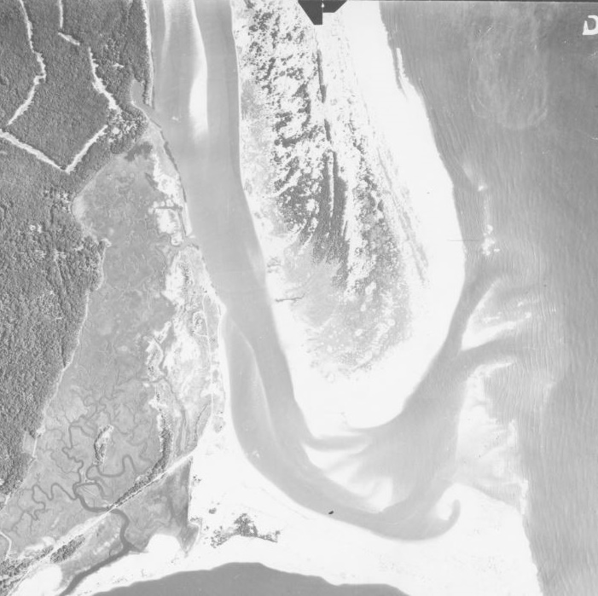
1943

Slide 7
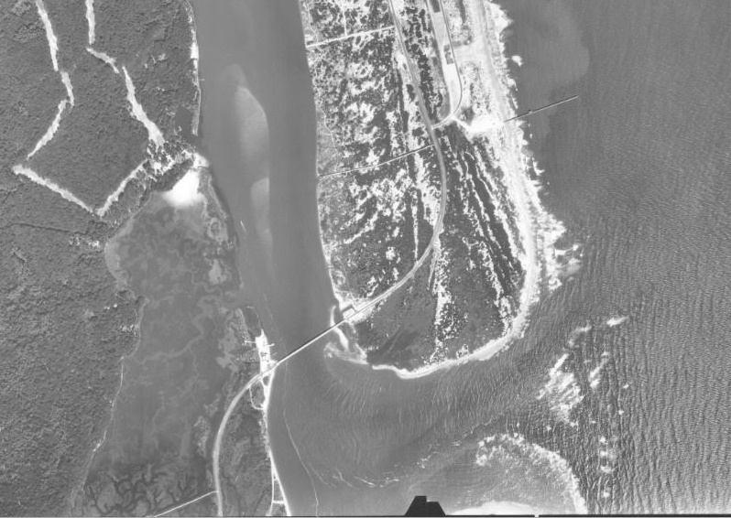
1960

Slide 8
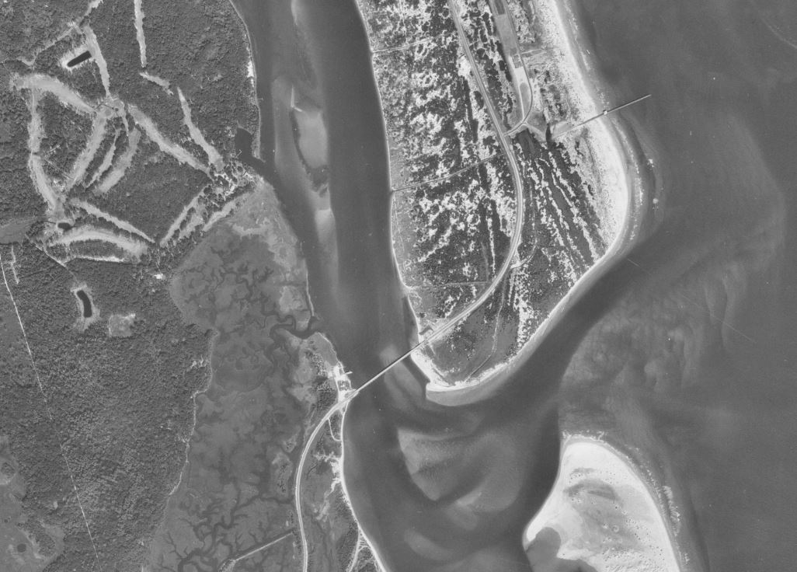
1970

Slide 9
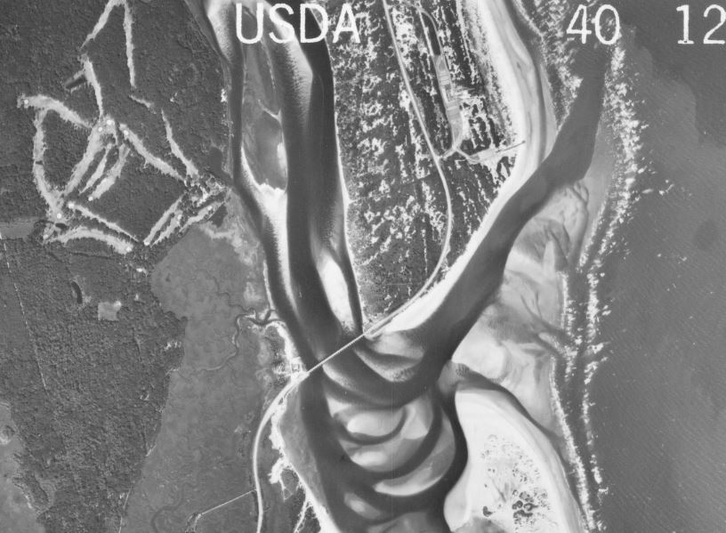
1980

Slide 10
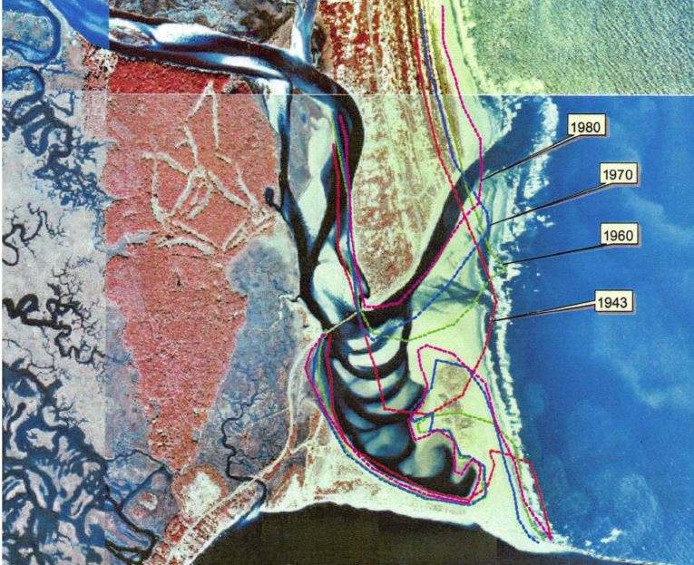
1943 - 1980

Slide 11
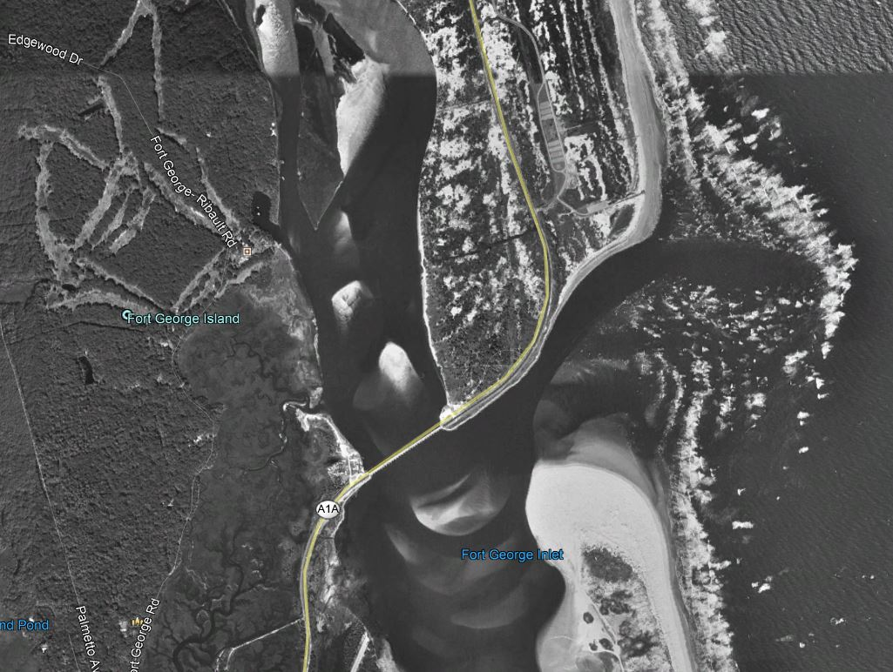
1994

Slide 12
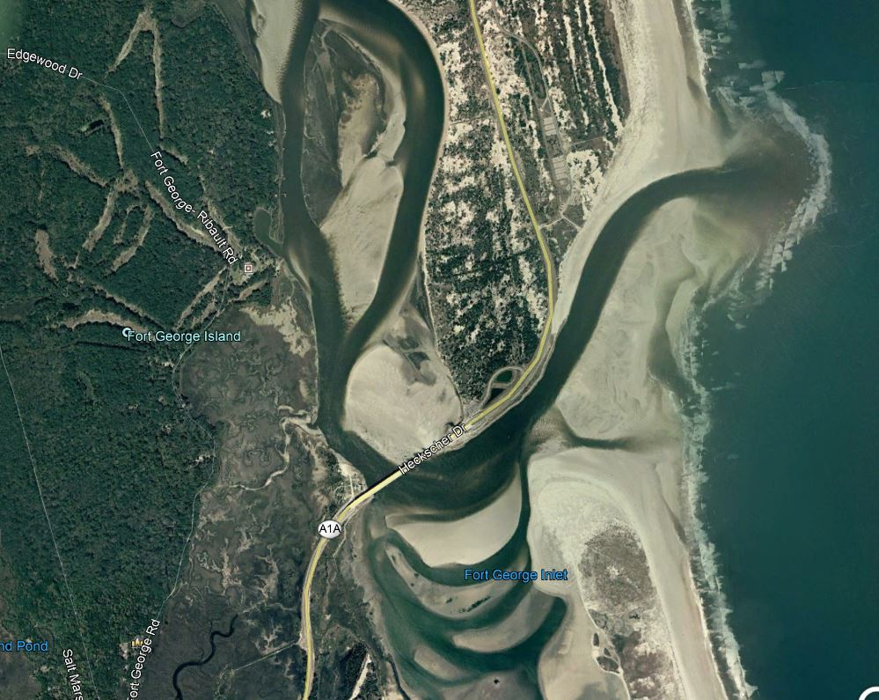
2006
Google Earth

Slide 13
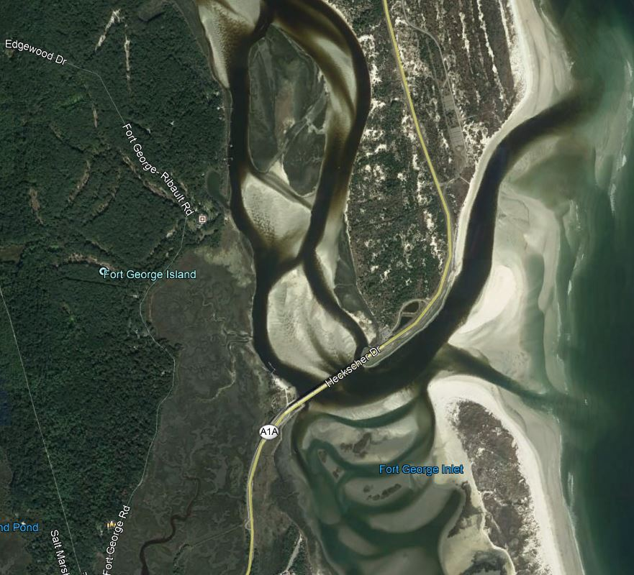
2018
Google Earth

Slide 14
What’s Happening Now?
South Shore of Talbot Island Continues to Erode
Inlet Continues to move North
River Filling with Sand
Wards Bank Continues to Grow
Hydraulics of Inlet = Net Import of Sand
Google Earth

Slide 15
What if the Inlet Closes?
Simpson Creek Ceases to Flow
Loss of Boater Access to the River
Potentially Irreversible
Area-Wide Ecological Impacts Expected
Huguenot Park becomes part of Talbot Island State Park, No Beach Driving
Google Earth

Slide 16
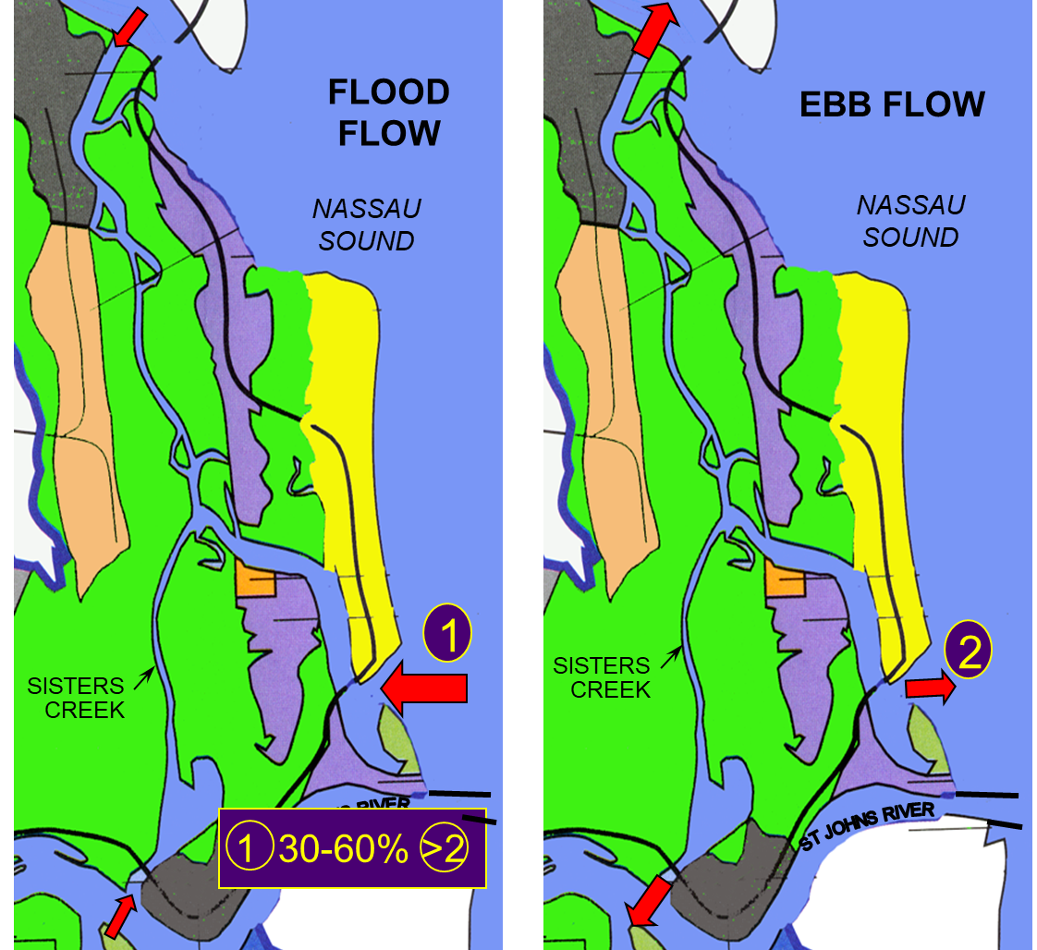
What’s Causing this Problem?
1999

Slide 17
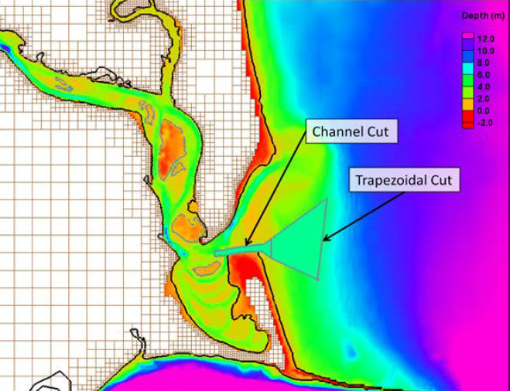
Possible Solution
USACE
2015

Slide 18
Fort George River - Next Steps
1999, 2002 & 2015 studies agree that the Inlet will eventually close if no action is taken
Recent guidance regarding the Coastal Barrier Resource Zone Act provides an opportunity for Federal Assistance
Convene Stakeholder Meeting to Discuss Options?

